Slide 1

Real Estate Sales and Fire Safety Compliance with AWS
Group 1
Bitterlein Konnoth Biju
Tal Benhamou
Sheng-Han Yueh
Yudhishna Kuppala
May 07, 2024

Slide 2
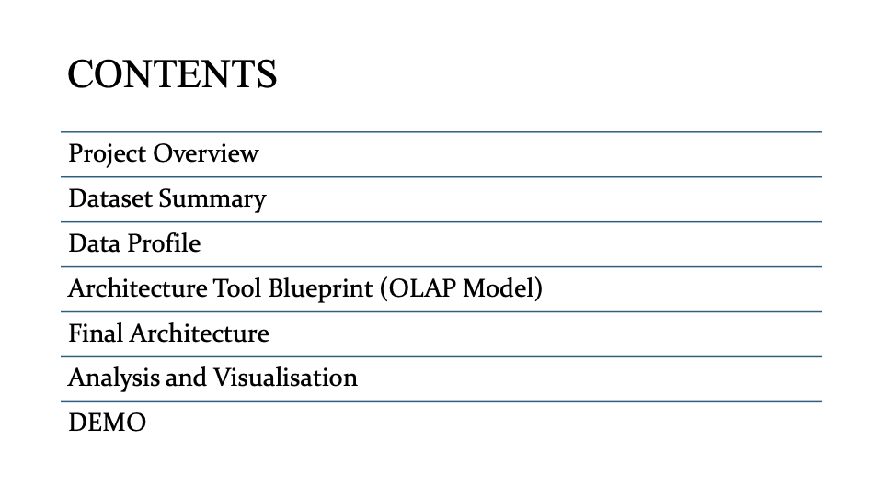

Slide 3
INTRODUCTION
Research question:
How do fire incident history, property values, and community safety interact within New York City neighborhoods, and what insights can be gleaned to identify the safest boroughs?

Slide 4
Datasets Summary
3 data sources:
Historical Certificates of Fitness -data link
Nyc Annualized Calendar Sales - data link
Fire Inspection (API)- data link
Operations on the datasets done:
Merged on the 'BIN' variable (Building Identification number)
Data cleaning
Data transformation
Subset selection

Slide 5

Data Pipeline

Slide 6
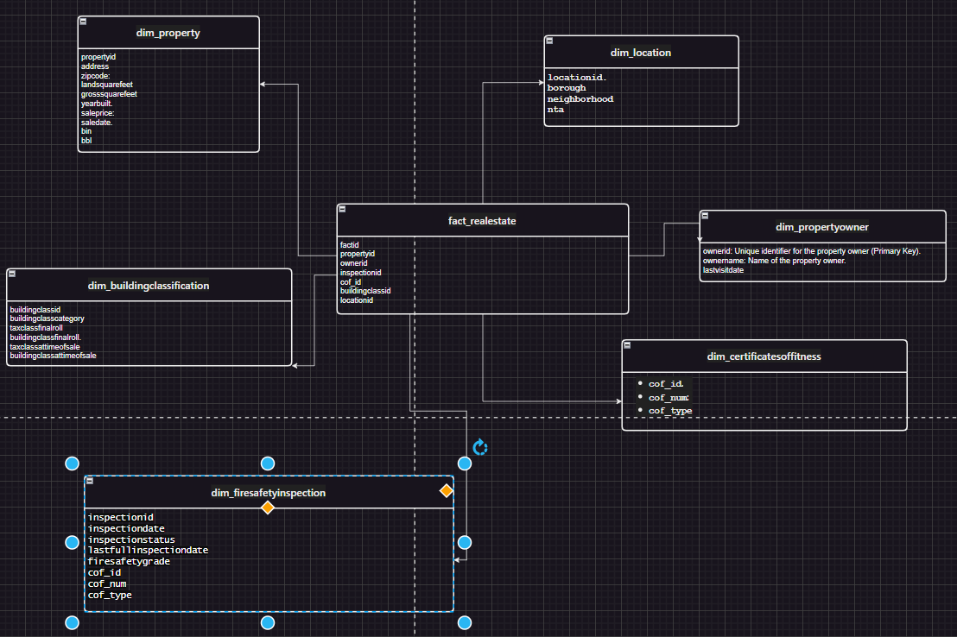
Conceptual Model

Slide 7
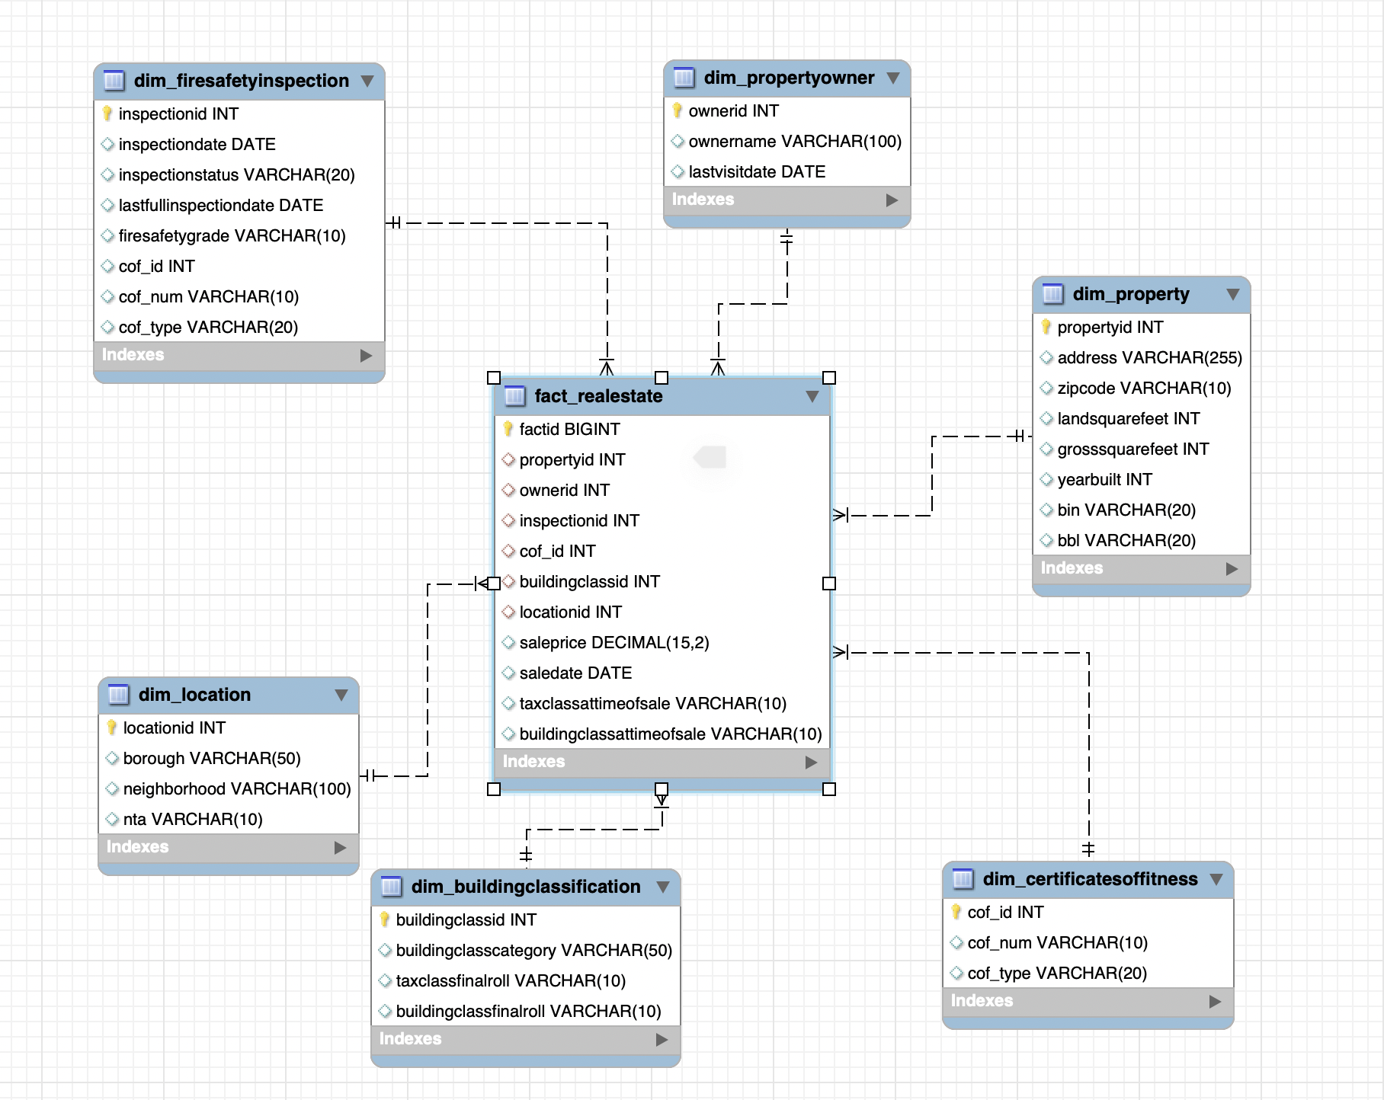
Physical model

Slide 8
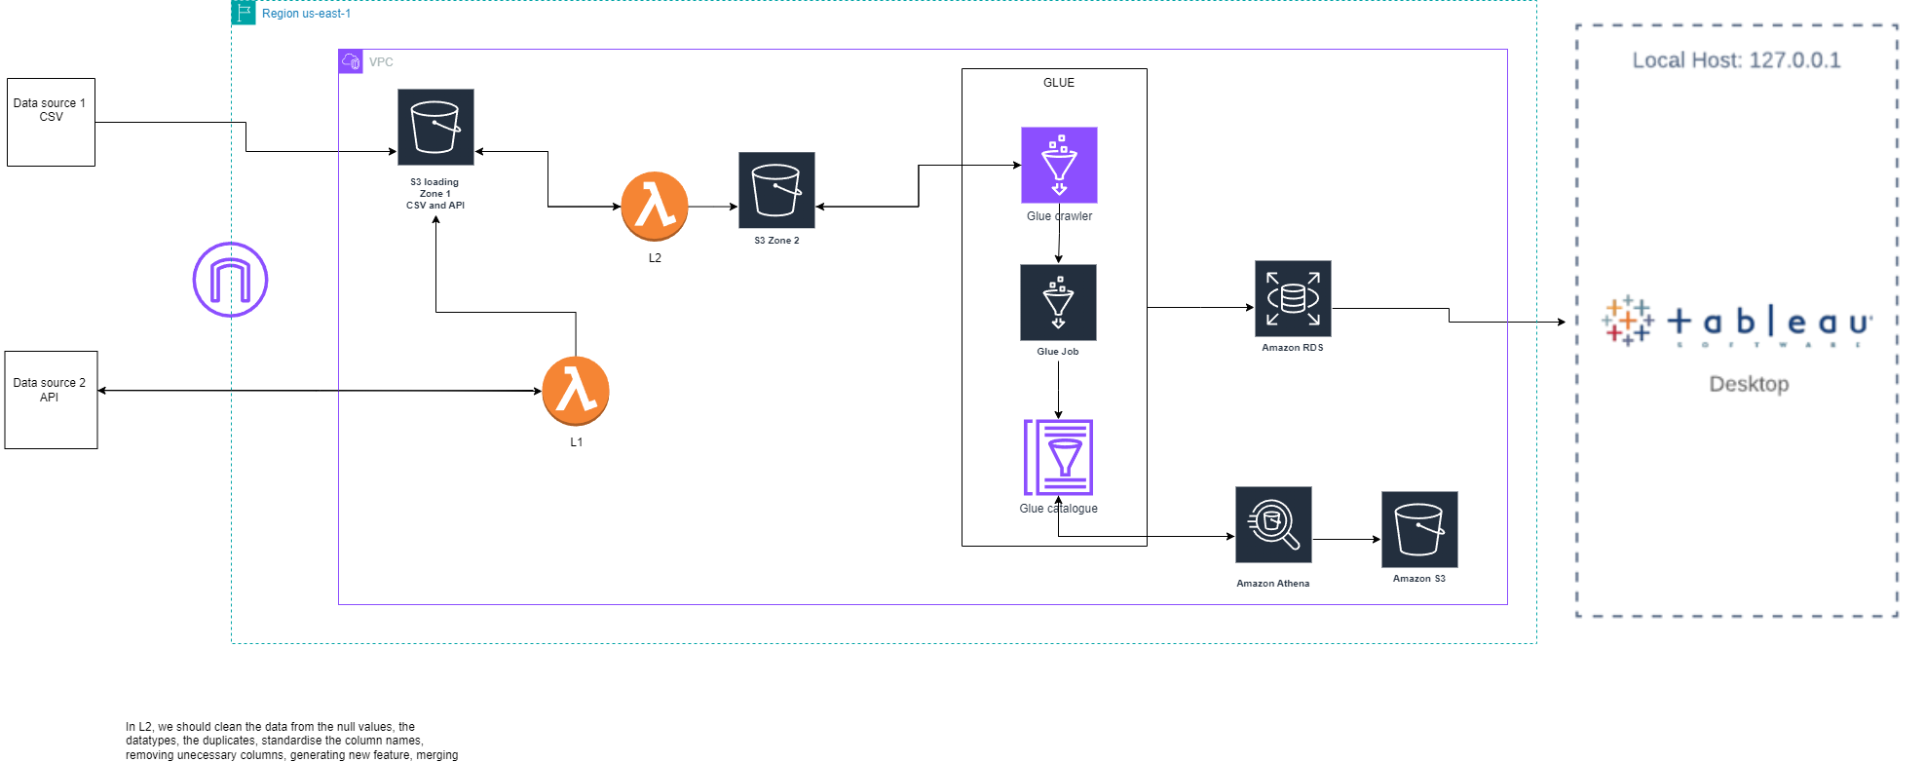
Planned AWS architecture

Slide 9

Final AWS architecture

Slide 10

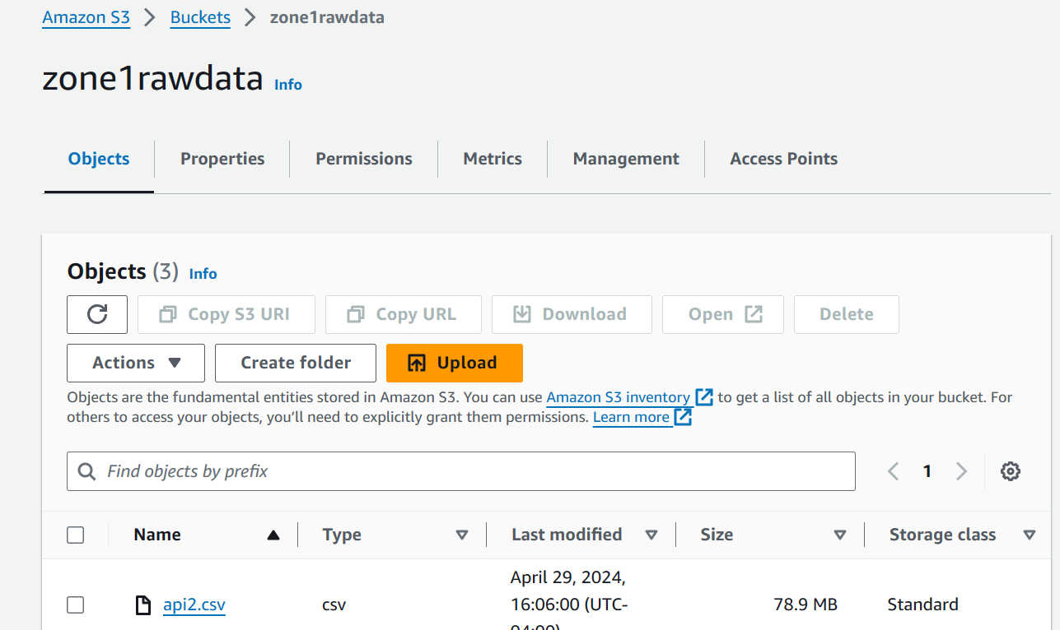
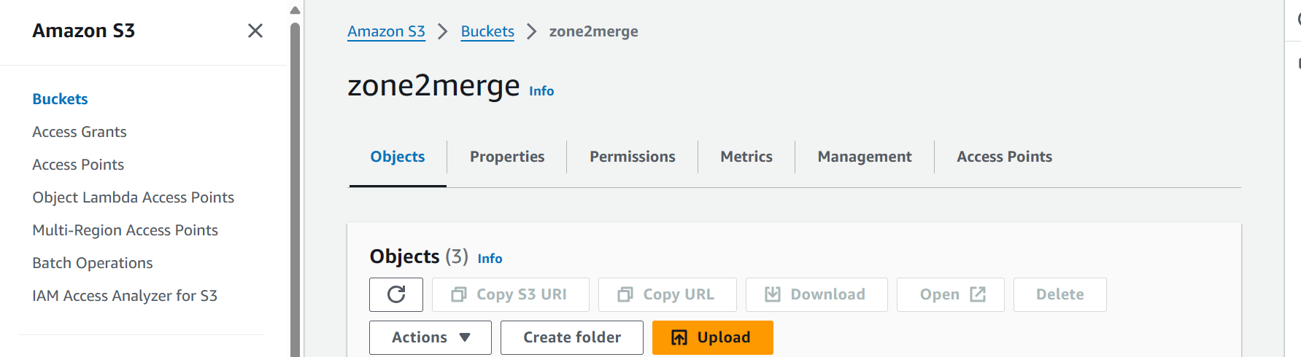
S3 buckets
We have two s3 buckets one for raw data and another for cleaned data after going through lambda function
Raw data s3 bucket - s3 bucket raw data
Cleaned data s3 s3 bucket cleaned data

Slide 11

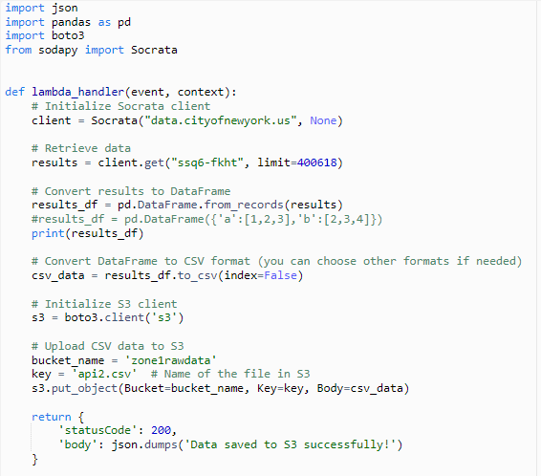
Data Retrieval and Pre-processing
Lambda 1:
Create a lay Lambda 1:
er than contains “pandas and sodapy”
Connected to api and stored as csv file
Stored in a S3 bucket (Zone 1)
Lambda 2:
Read file through S3 bucket (Zone 1)
Clean data, imputation
Mapping the borough
Merge data
Stored in a S3 bucket (Zone 2)

Slide 12
ETL Process

Slide 13
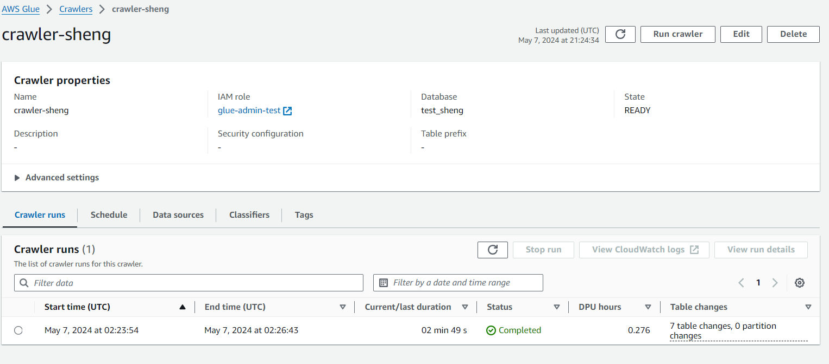
GLUE CRAWLER

Slide 14
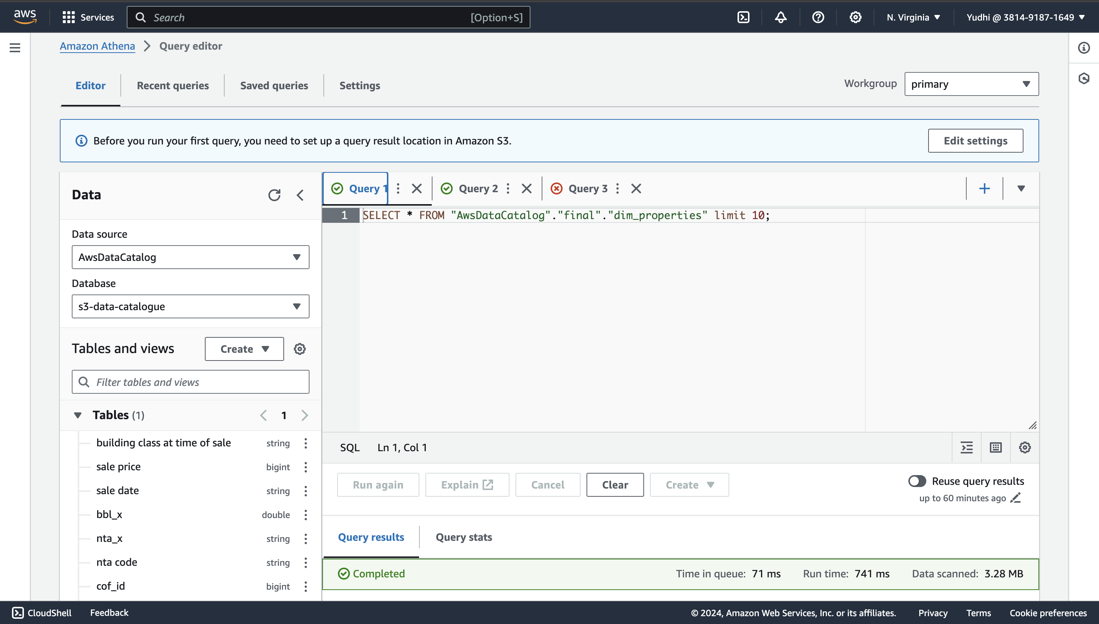
AWS ATHENA

Slide 15
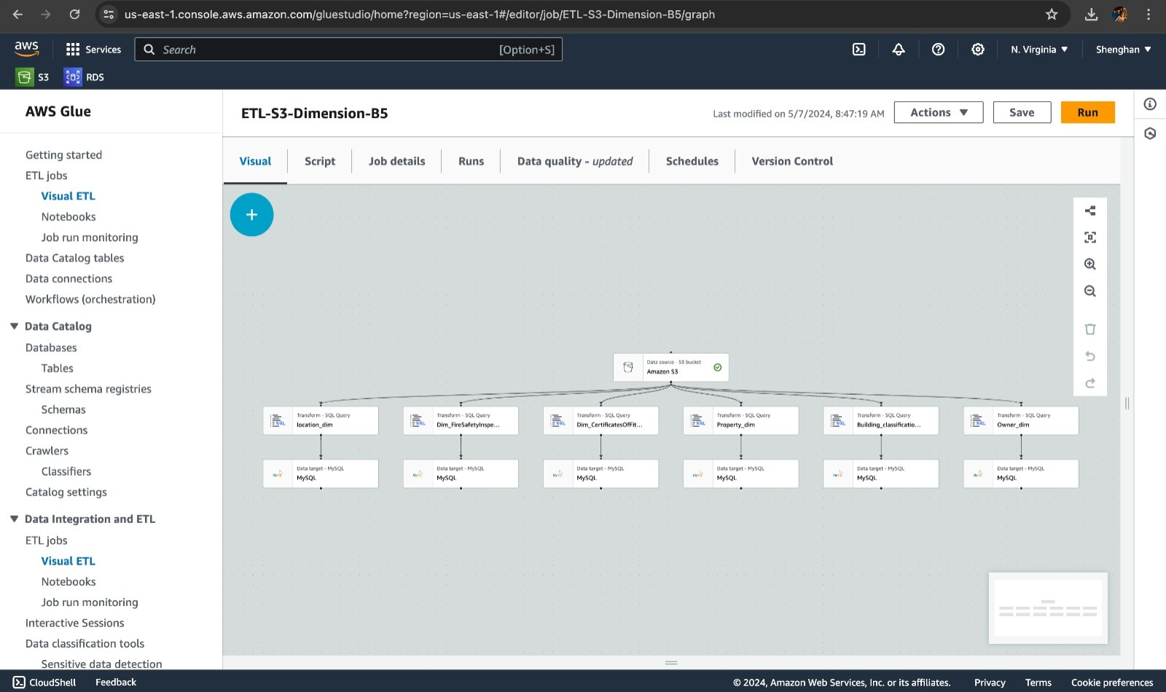
GLUE JOB

Slide 16
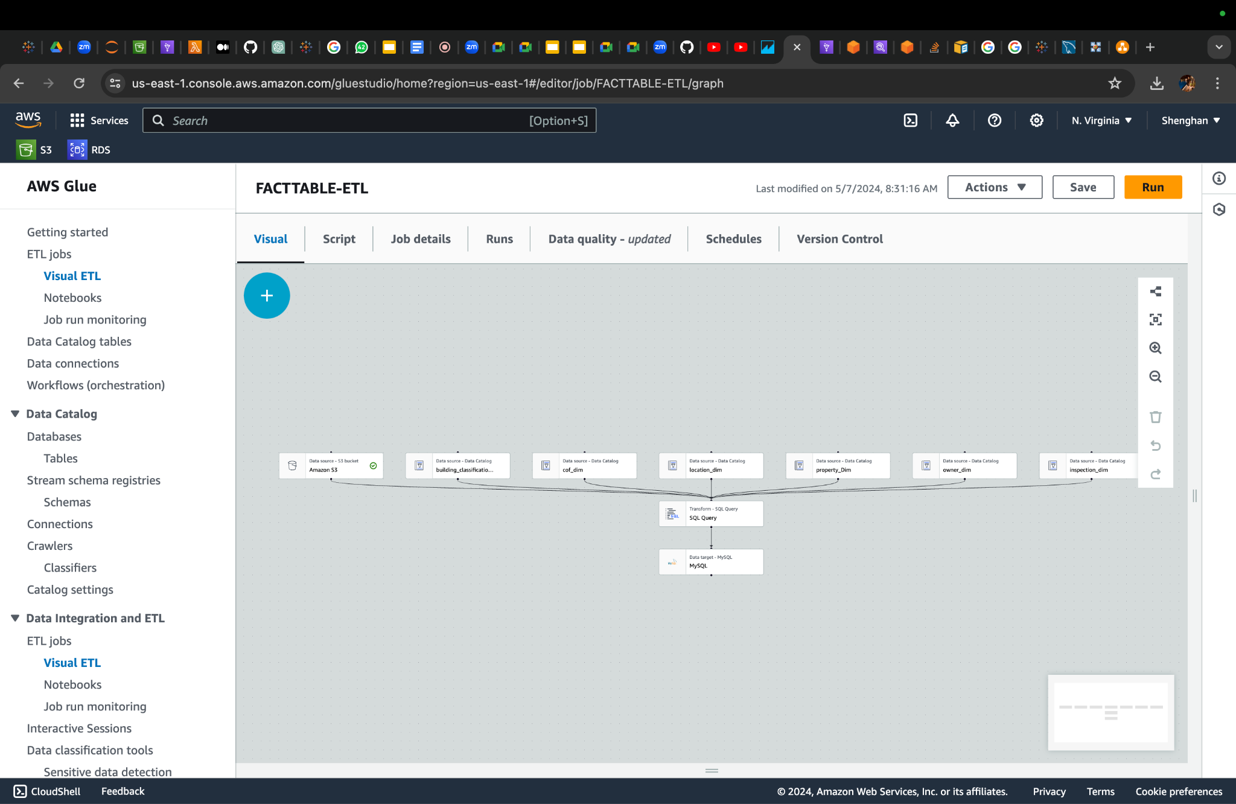
GLUE JOB

Slide 17
ANALYSIS

Slide 18
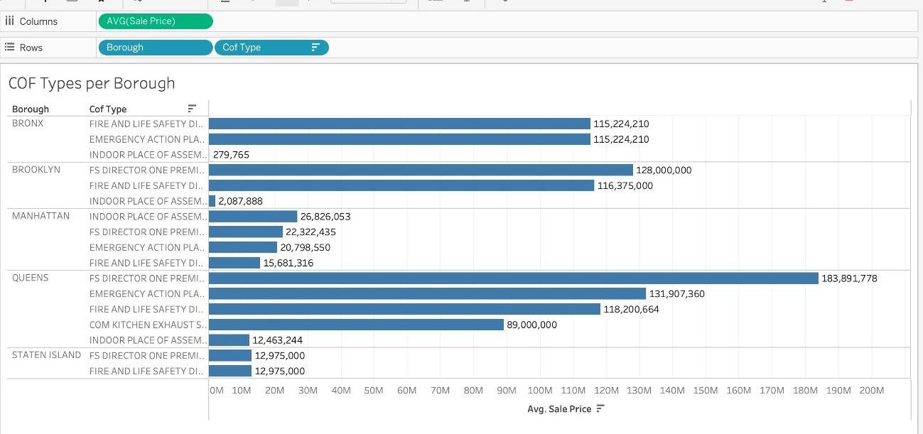
How does the presence of high-value Certificate of Fitness (COF) types, correlate with the average sale prices of properties?

Slide 19
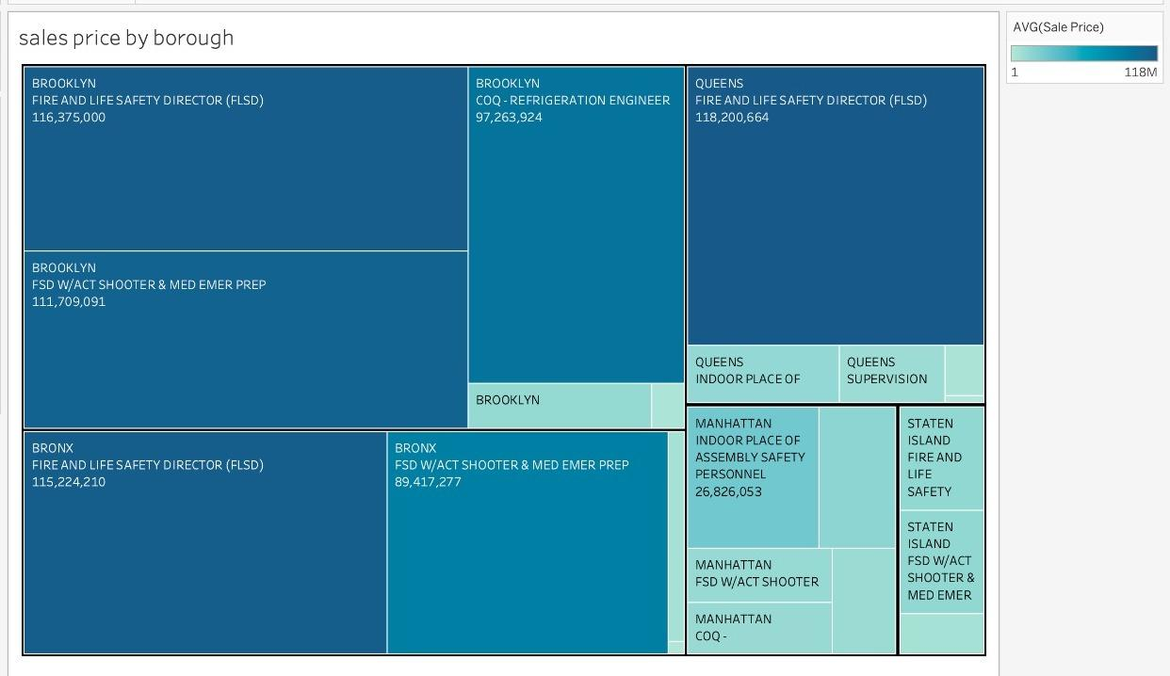
How do the average sale prices vary across different boroughs for specific Fire Safety Inspection Certificate types, and what insights can be drawn regarding the property characteristics and market trends within each borough based on these variations?

Slide 20
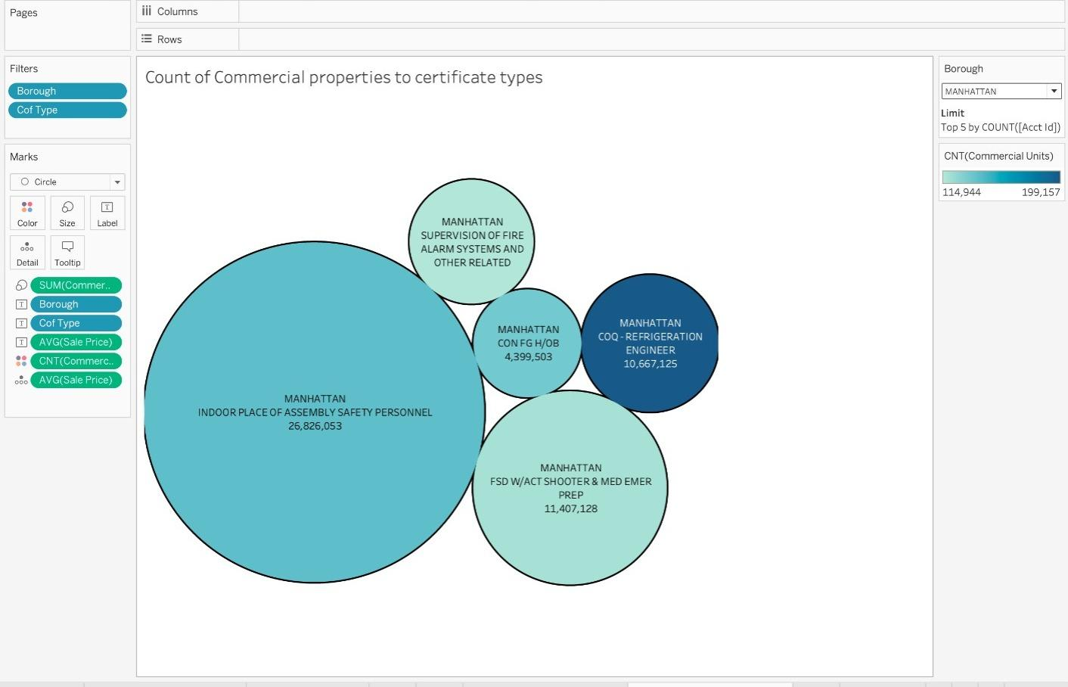
How do the count of commercial units and the sale prices of properties associated with specific Fire Safety Inspection Certificate (Cof) types in Manhattan correlate, and what implications does this relationship have for investment strategies and future commercial development in the area?

Slide 21
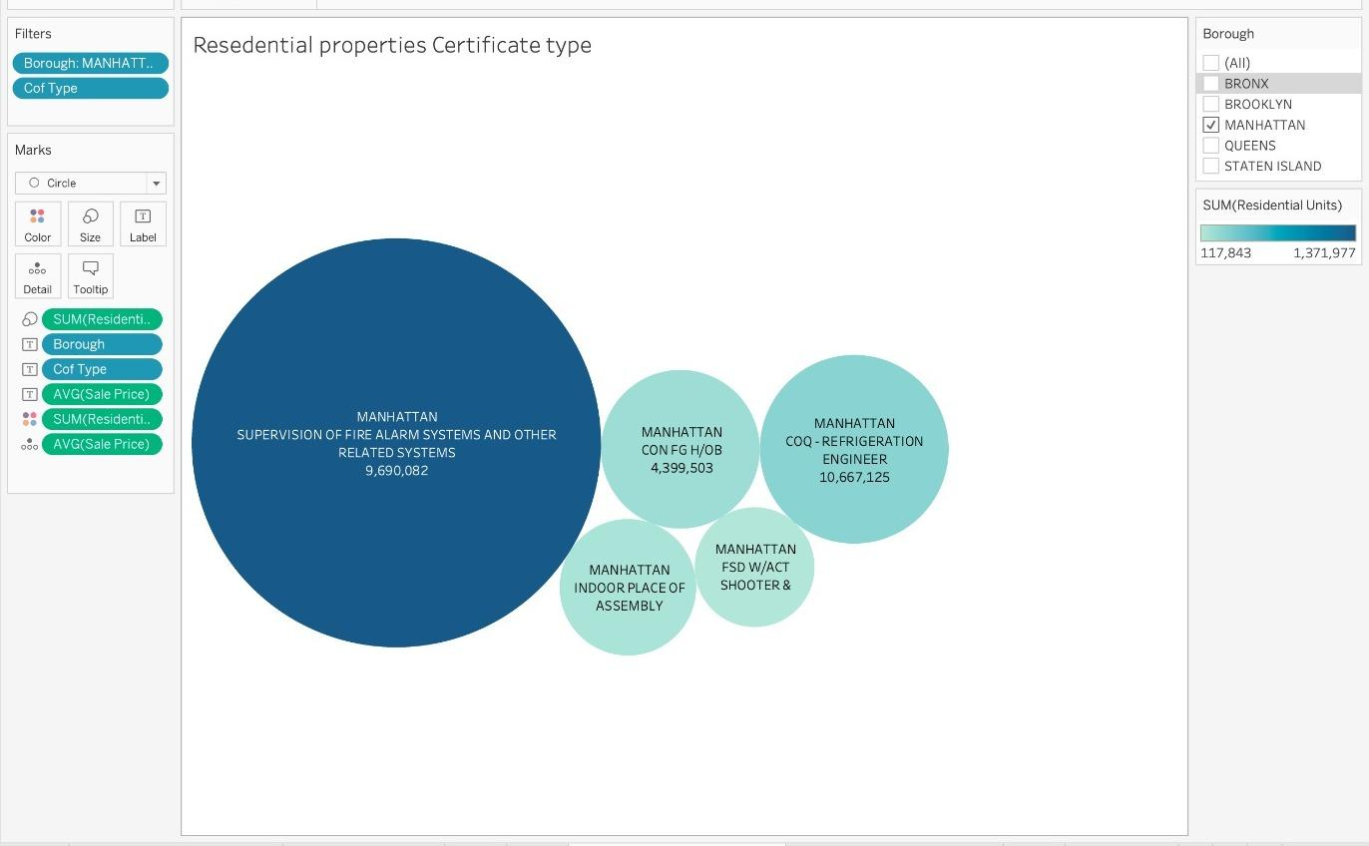
What is the relationship between the average sale price of properties and the number of residential units associated with specific Fire Safety Inspection Certificate (Cof) types, and how can this correlation inform investment decisions and development strategies in the residential real estate market?

Slide 22
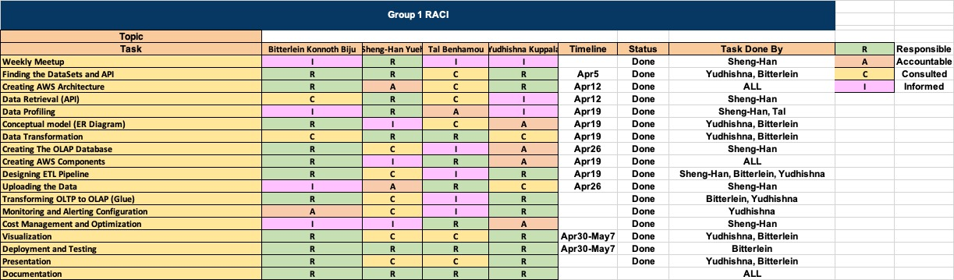
RACI

Slide 23
CONCLUSION

